Slide 1




Facebook Data Analysis
Date : 05/05/2021
Course : Big Data Analytics
Notes:
https://www.freepik.com/free-vector/people-doing-different-actions_3521084.htm
https://www.freepik.com/free-vector/hand-drawn-people-doing-outdoor-activities_2620727.htm

Slide 2




People Profile
1
2
3
3
Guide
Presenter
Presenter
Name : Amit Ganatra
Name : Murli Alva
Enrollment No.: AU2044006
Name : Vatsal Suthar
Enrollment No.: AU2044013
Professor
Student
Student
Notes:
https://www.freepik.com/free-vector/colorful-collection-with-great-variety-avatars_1258263.htm

Slide 3



Agenda
Project Overview
01
Dataset Details
02
Data Preprocessing
03
Data Analysis
04
Model
05

Slide 4
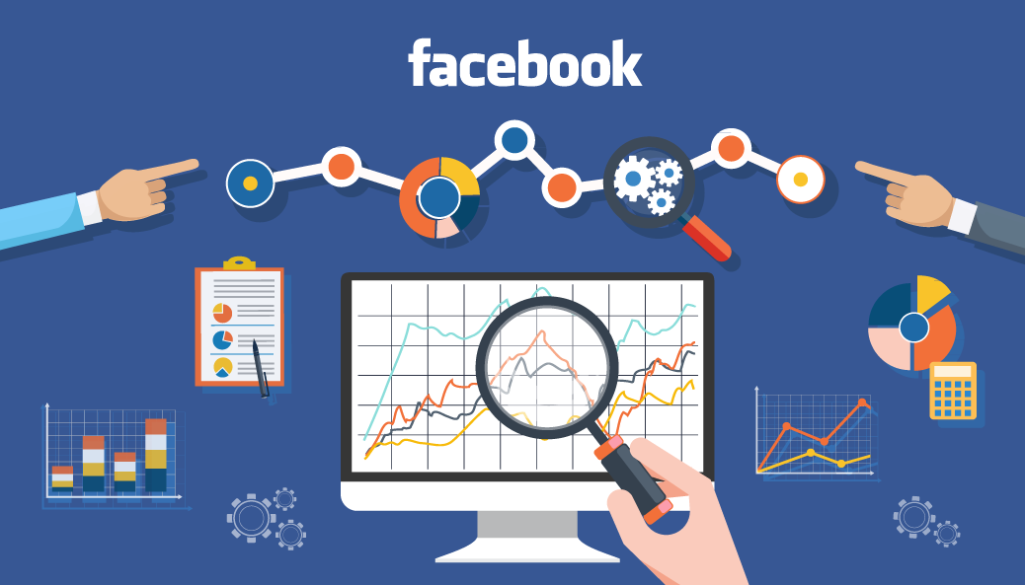
Project Overview
Smart phone without social media usage in daily lifestyle of people is unthinkable. That much effect has been created in the lifestyle of people by smartphone and social media. There are many social media such as Facebook, Twitter, etc., As per 2017 statistics, nearly 1.37 billion daily active users for Facebook. Every user contributes some type of data to in structured or semi-structured or unstructured data format. Business owners utilize this data to understand customer need and their behavior to make profit in their business. Facebook data analysis is the process of collecting, analyzing Facebook data and visualizing extracted results to the end user.
The user data is collected from Facebook based on their activities. User behavior, number of likes, number of posts, type of posts, their comments, etc. are stored by the database server. Comments by the user in unstructured formats, while other data in structured and semi-structured format. Petabytes of data is generated by Facebook users. So Spark, RDD and related big data concepts used in this project to analyze the data.

Slide 5
Dataset details
Data source : Kaggle
Rows : 198007
Columns : 15
Size : 50mb

Slide 6
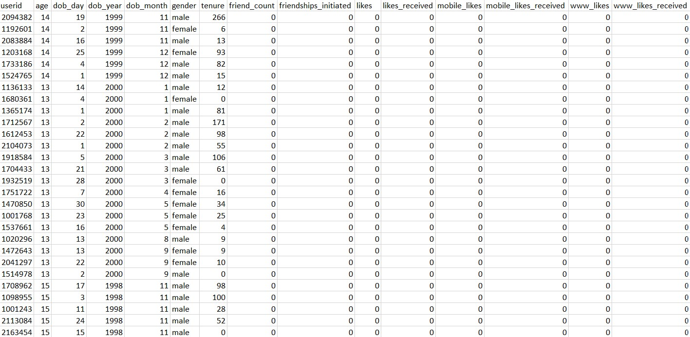
Dataset Screenshot

Slide 7
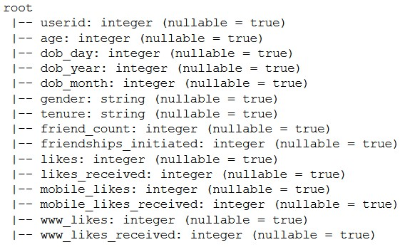
Variables
Columns names
Schema
Age dob_day dob_year dob_month
gender
tenure friend_count friendships_initiated likes / likes received mobile likes / likes
received
www likes / likes
received

Slide 8
Data Preprocessing
Some of the steps we performed during the preprocessing part are
Pysaprk’s sql model to load data into DataFrame
Removing Null values
Dropping duplicate values
Removing outliers
Using standard scaler to normalize the data

Slide 9
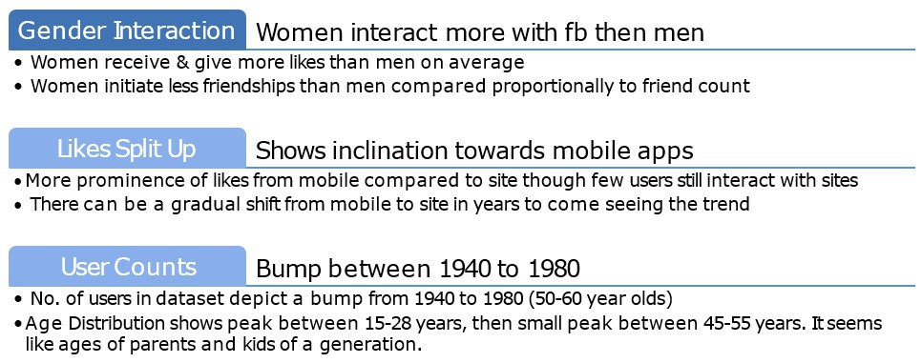

Exploratory Data Analysis : Key Insights

Slide 10
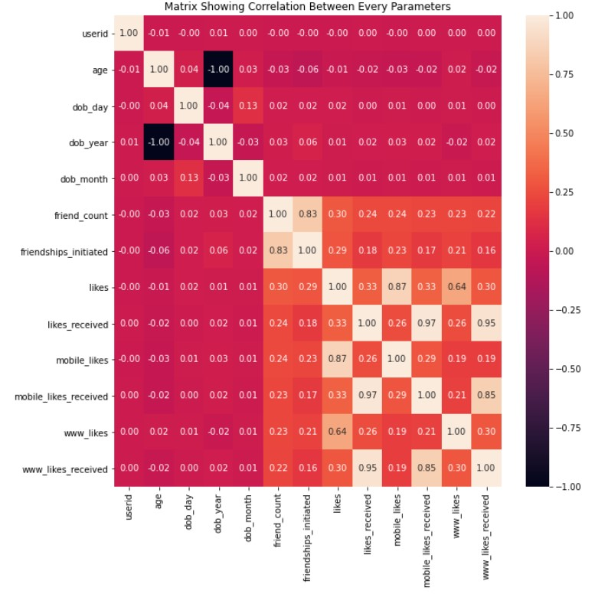
Correlation Plot
Friend count & friendships initiated are strongly correlated
Ignore correlations of subsets of likes & likes received (mobile & site likes/likes received)
Tenure and Age also seem to be related

Slide 11
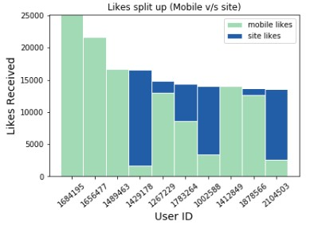
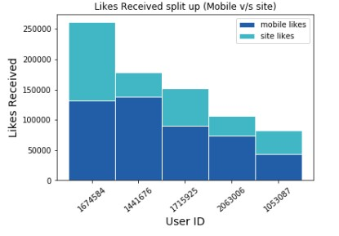
Likes given
▶ It's a one to many relationship, a user gives likes to many people.
▶ Top 4,6,7 & 10 user prefer the site more than mobile app
▶ Still a general skew towards mobile
app
Likes Received
▶ It's a many to one relationship, many people give likes to a user.
▶ Top users likes show shift of people preferences towards mobile apps rather than site (mostly higher mobile likes than site likes)

Slide 12
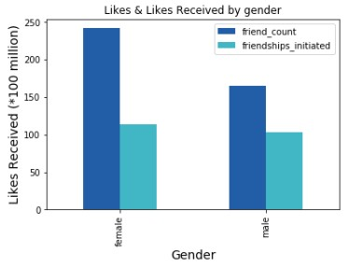
Gender Specific Interaction
▶ The dark blue one is likes received and green is the likes.
▶ Women's give and receive more likes than men (nearly 1.5 as much).
▶ Likes given & likes received are comparable to each other for both men & women.
▶ Same behavior is true when the likes/like received are split up between mobile & site (nearly 3 times more for women than men)

Slide 13
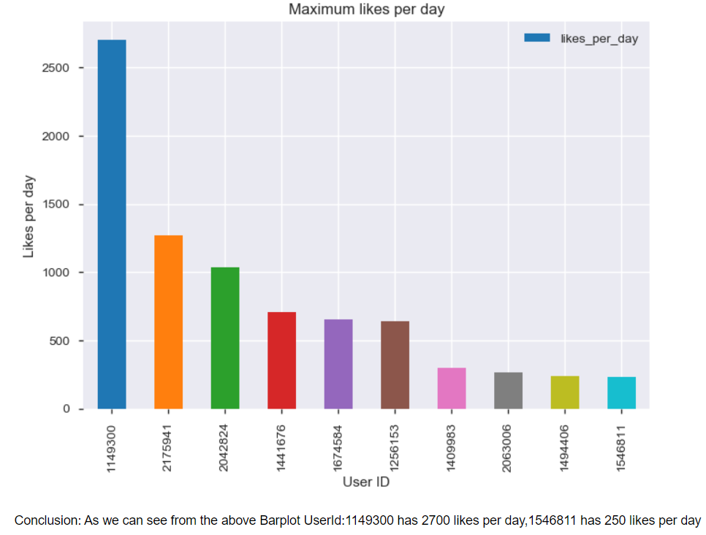
Maximum likes per day
▶ This chart shows the user with max likes per day from the dataset.
▶ As we can see from the chart user Id 1149300 has 2700 likes per day while user 1546811 has 250 likes per day.

Slide 14
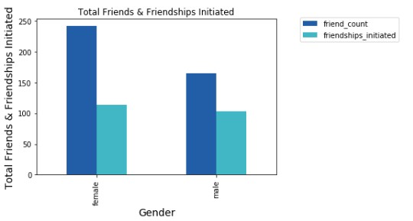
Women have more friends than men on Facebook, the friendships initiated in proportion to friend count are more in case of men than women
Fact: A Pew Research Center survey found that 75% of women use Facebook, compared with only 63% of men.

Slide 15
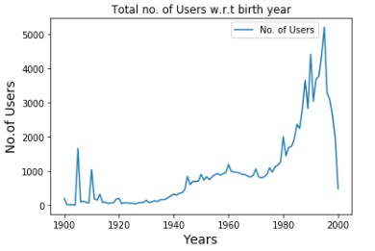
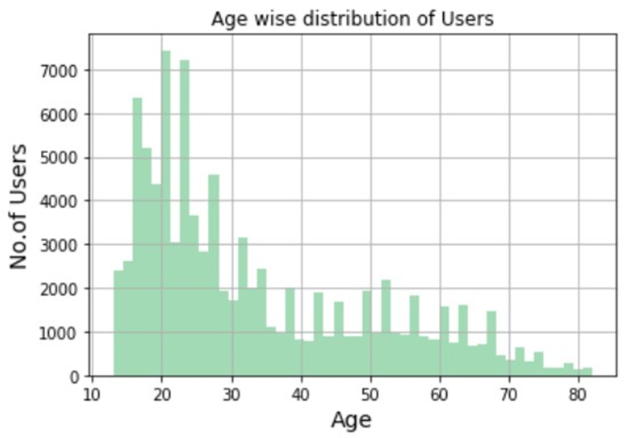
Users w.r.t birth year
We see bumps between 1940 to 1980. After 1980 the no. users rocket. Since the data is till 2000 (we see miniscule value in 2000)
Age Distribution shows peak between 15-28 years, then small peak between 45-55 years. It seems like ages of parents and kids of a generation.

Slide 16
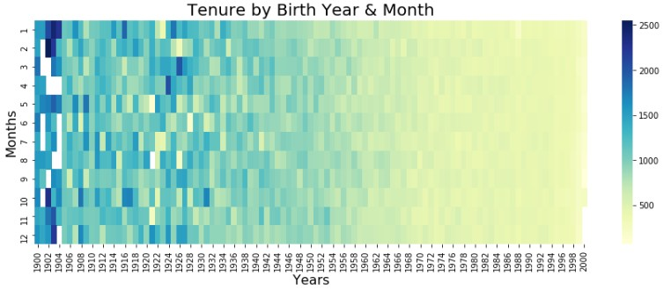
Users w.r.t birth year
Tenure by Birth Year & month
The early years seem to have more mean tenure, might be facebook pages or public user accounts that are mass followed

Slide 17
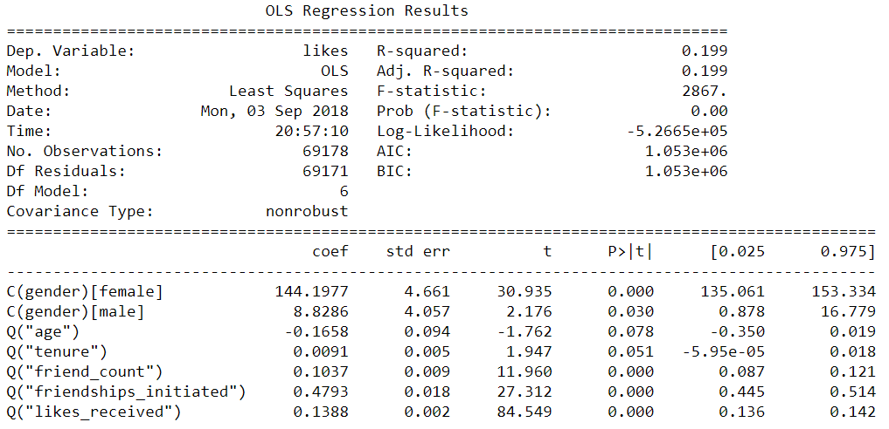
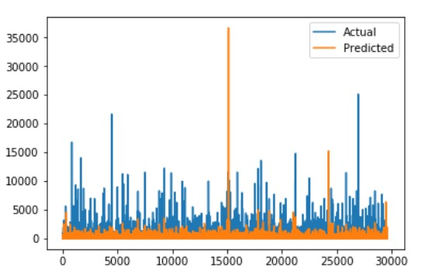
Users w.r.t birth year
Modelling
Equation: likes ~ age + tenure + friend count + friendships initiated + likes received + gender

Slide 18
Thank You!

